Slide 1



Voting-Console Application
EEE 206 - PROGRAMMING
Project
Project No: 2
Team Members
Batuhan Yaman(EEE)
Ömer Tezel(EEE)
Ali Yener Dikmen(EEE)

Slide 2
Project Goals
Create a program that people can login with their ID’s and passwords to vote about an issue.
Users can vote yes, no, or they can stay abstain.
Users should be able to change their passwords and votes if they want.
Save to file user passwords and their votes.

Slide 3
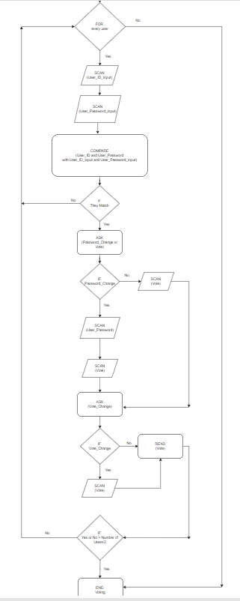
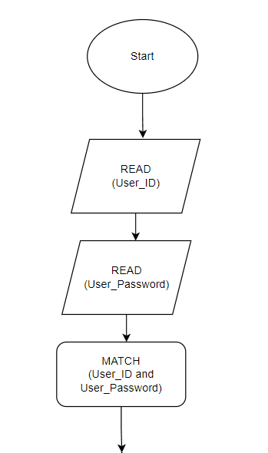

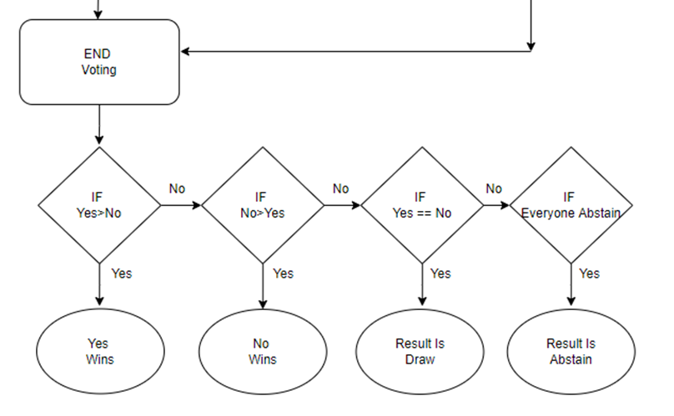
Flow Chart
Figure 1.: Beginning of the algorithm
Figure 1.3: End of the flow chart
Figure 1.2: For Loop

Slide 4
Pseudo Code
//pseoudo code of the algorithm
READ(User_ID);
READ(User_Password);
MATCH(User_ID and User_Password);
FOR every user
SCAN(User_ID_input);
SCAN(User_Password_input);
COMPARE(User_ID and User_Password with User_ID_input and User_Password_input);
IF they match
ASK(password_change or vote);

Slide 5
Pseudo Code
IF password_change;
SCAN(User_Password);
SCAN(vote);
IF vote
SCAN(vote);
ASK(vote_change);
IF yes
SCAN(vote);
READ(vote);
IF yes or no > number of users/2
END voting;

Slide 6
Pseudo Code
END FOR;
IF yes>no
yes wins;
IF no>yes
no wins;
IF yes == no
draw;
IF everyone abstain
result is abstain;

Slide 7
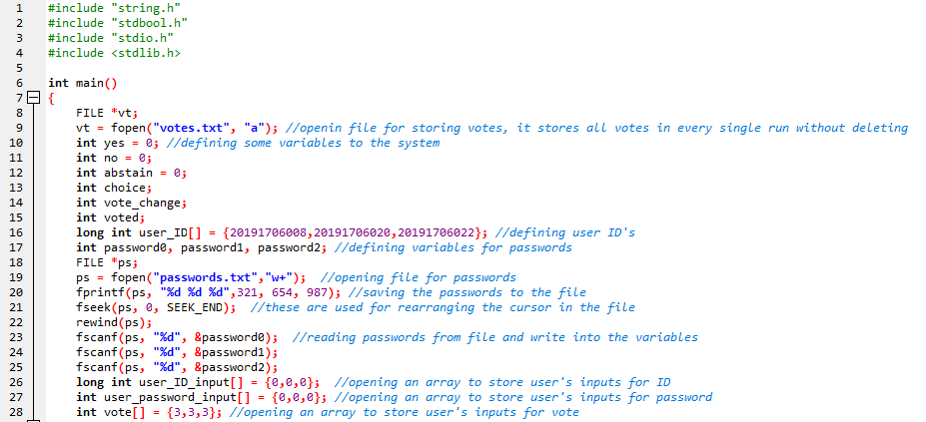
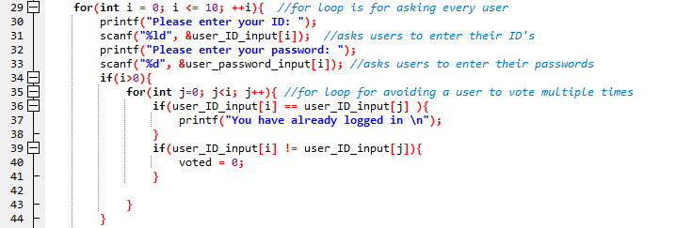
C SCRIPT OF THE PROGRAM
Figure 2.1: The first part of our code
Figure 2.2: Beginning of the for loop

Slide 8
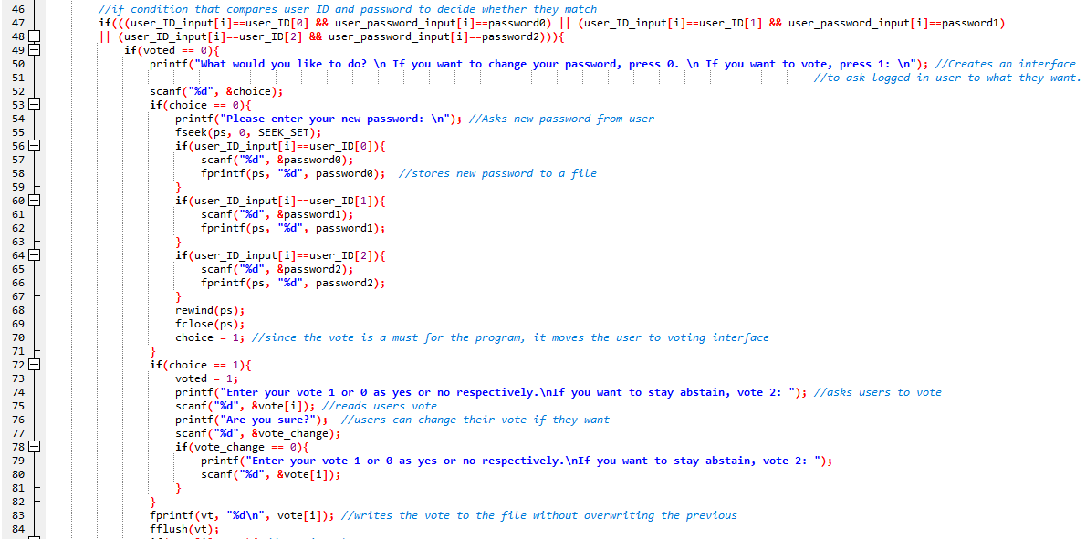
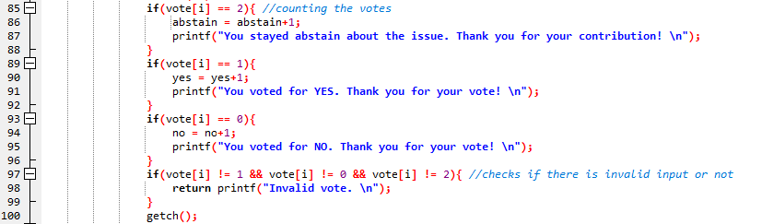
C SCRIPT OF THE PROGRAM
Figure 2.3: User interface
Figure 2.4: Vote counting

Slide 9
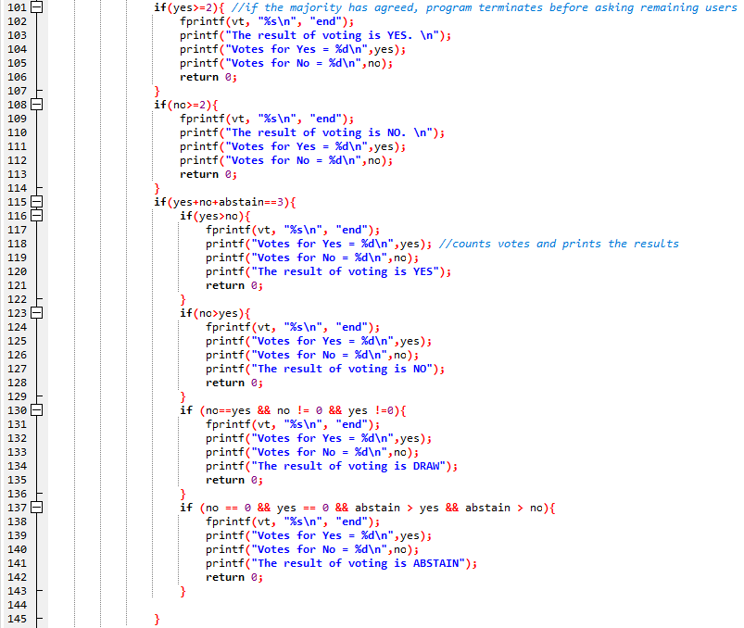
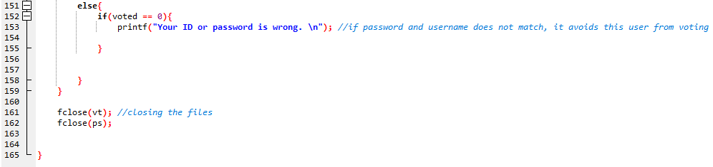
C SCRIPT OF THE PROGRAM
Figure 2.6: End of the code
Figure 2.5: Printing the result

Slide 10
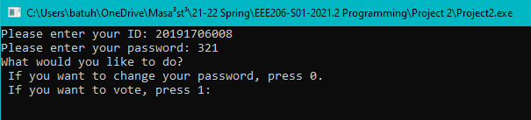

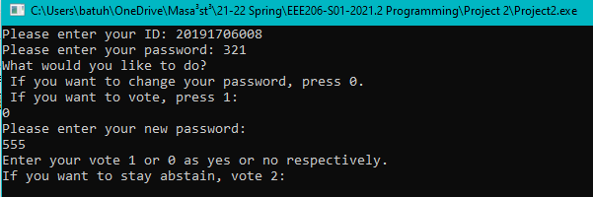


SIMULATIONS
Figure 3.1: Successful login
Figure 3.3: Inside of the password.txt
Figure 3.4: Inside of the updated text file
Figure 3.2: Entering new password

Slide 11
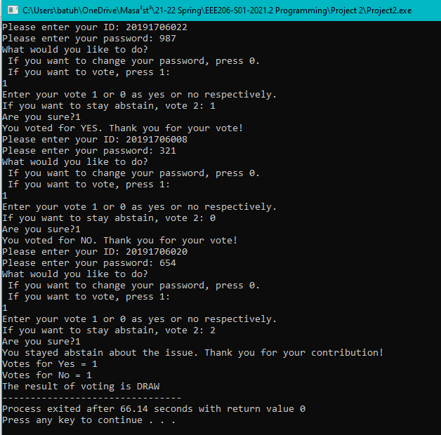
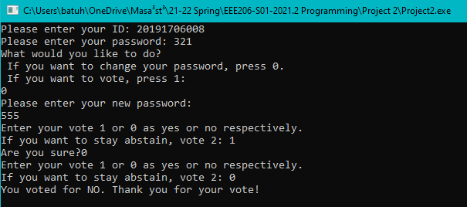
SIMULATIONS
Figure 3.5: Voting process
Figure 3.6: Last user is voting

Slide 12
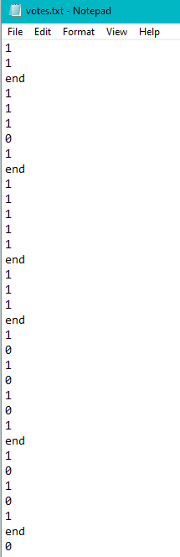
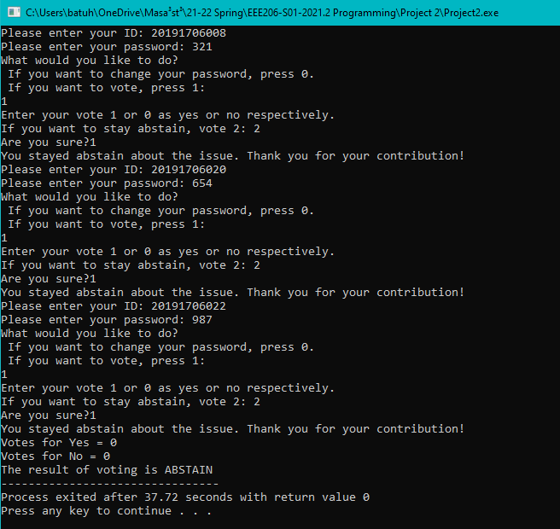
SIMULATIONS
Figure 3.7: Abstain result
Figure 3.8: Stored votes

Slide 13
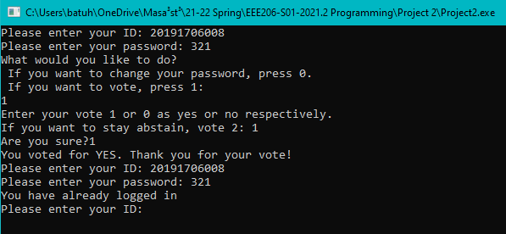
SIMULATIONS
Figure 3.13: Same user tries to login again

Slide 14
Conclusion
we created a console application where users can log in with their password and username and vote on a topic. In our system, users can change their passwords if they wish. Finally, when the voting is over, the voting result is displayed according to the votes used or abstentions.

Slide 15
Acknowledgment
We would like to express our thanks of gratitude Dr. Doğan ÇÖRÜŞ for his help and support.
Thank you for listening to us!

